Slide 1

A Complete Data Analysis of
Students Performance in Exams
Presented by
ARCHANA S

Slide 2

CONTENTS
Objective
About the Data
Data Description
Analysis
Visualization
Conclusion

Slide 3

About Dataset statistics
Number of variables : 8
Number of observations : 1000
Missing cells : 0
Missing cells (%) : 0.0%
Duplicate rows : 0
Duplicate rows (%) : 0.0%
Total size in memory : 62.6 KiB
Average record size in memory : 64.1 B
Shape of the data : (1000,8)
Variable types : Categorical : 5 ; Numeric : 3

Slide 4

Description
This data set consists of the marks secured by the students in various subjects. This data set includes scores from three exams and a variety of personal, social, and economic factors that have interaction effects upon them.
The inspiration of this Data Analysis to understand the influence of the parents background, test preparation etc on students performance

Slide 5
DATA DICTIONARY
Column Name | Description
Gender | Sex of the Students
Group | Ethnicity of students. 5 type of race. Group A B C D E
Parent Education Level | Education level of each student's parent
Lunch | Having lunch before test (normal and abnormal)
Test Preparation Course | Complete or not complete before the test
Math Score | Students math Score
Reading score | Students reading score
Writing score | Students writing score

Slide 6

Data Analysis

Slide 7
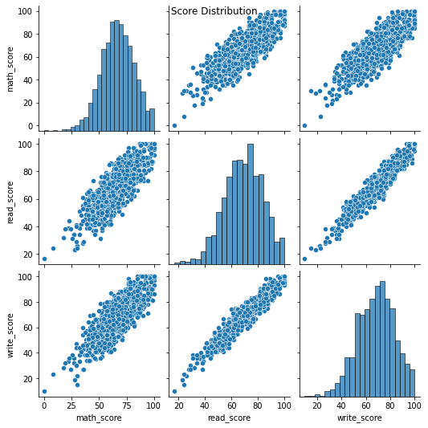
Score Distribution
From the given data, we can say that most of the students are scoring an average marks of 50 to 70 in all the tests.We can see that there are very rare cases where people are good at a particular subject, most of the students are performing equally in all the subjects, we can observe this from the relations between them.

Slide 8
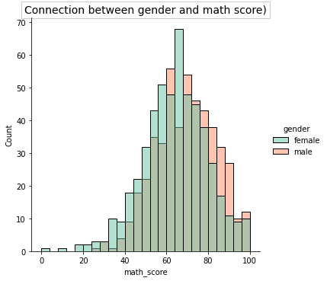
The mean 75%-25% Male scored in math than female

Slide 9
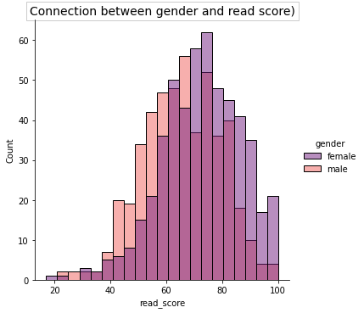
The mean 75%-25%Female scored better in Reading than Male

Slide 10
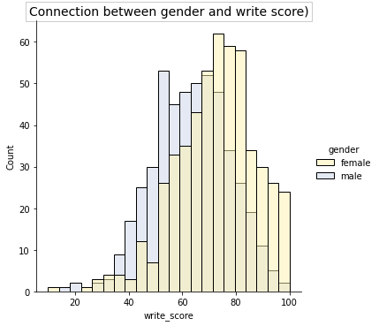
The mean 75%-25%Female scored better in Writing than Male

Slide 11
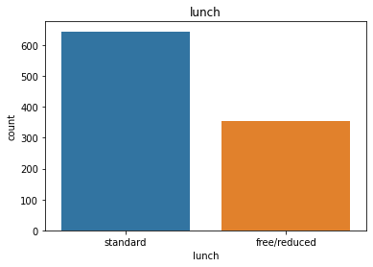

Slide 12
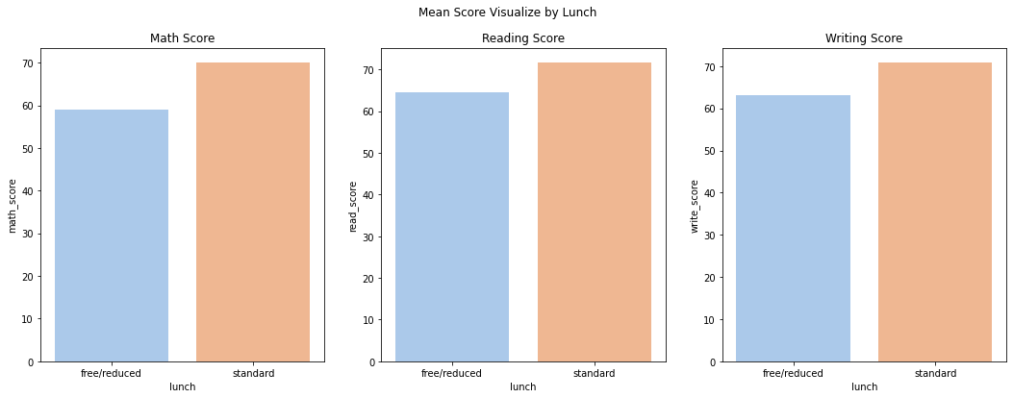
there are more students who have a standard lunch
Students with a standard lunch have high scores in exams
Students who have a standard lunch also have a high test score compared to free / reduced lunch

Slide 13
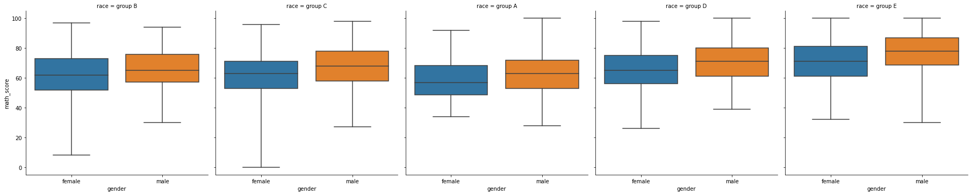
Maths score of Each group by Gender
Male from all groups A/B/C/D/E had score more higher than female
females had the lowest scores in Group B / C /D but the higher scores in Group B
in group E we can see that male and females are probably equalize

Slide 14
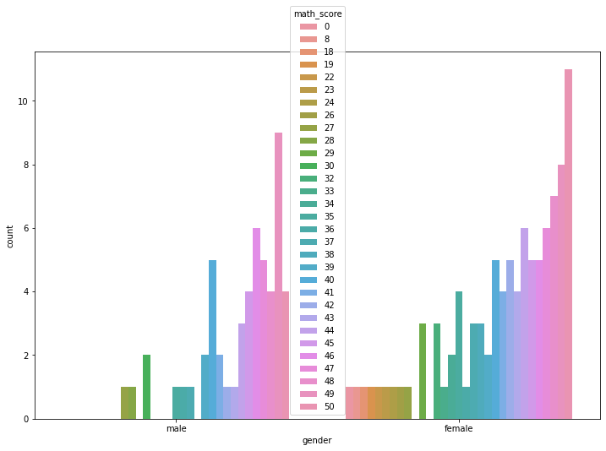
Male and Female Math Score below 50

Slide 15
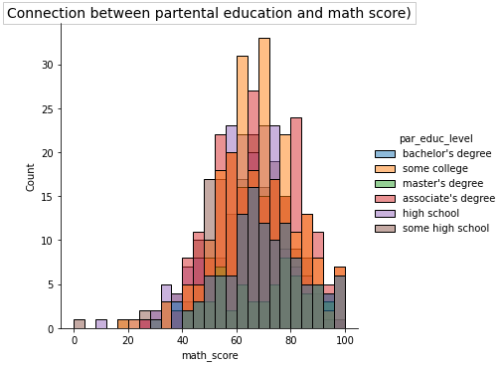

Slide 16
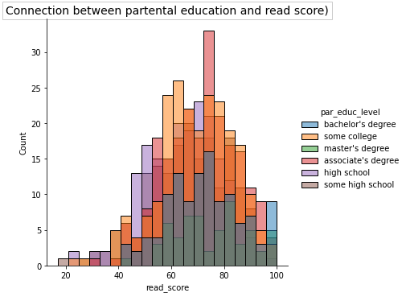

Slide 17
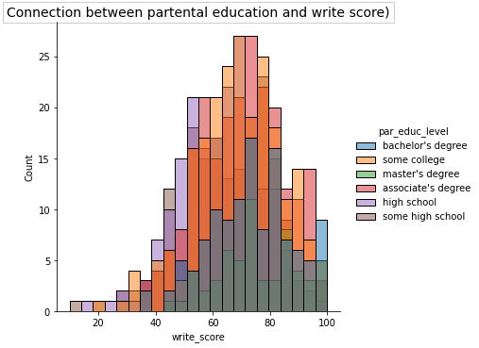

Slide 18
According to the Parental level course :
Here, Children with parents who have master level education, appear to get better grades and perform well in all aspects. Let's define the high degree of education. Parents having bachelor or master degree are high-level educated.

Slide 19
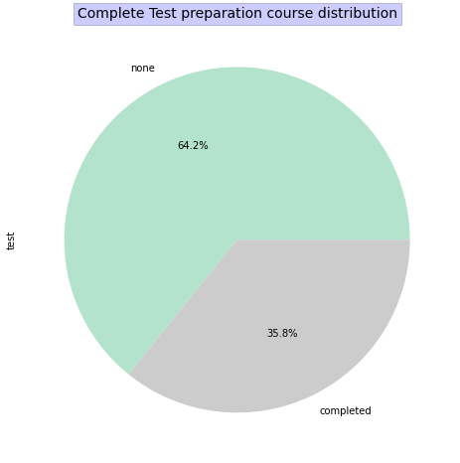
Over 35.8% of students completed the test preparation course, and normally there is about 60~70% students hadn't finished course. It is say that preparation course can help students get better score.

Slide 20
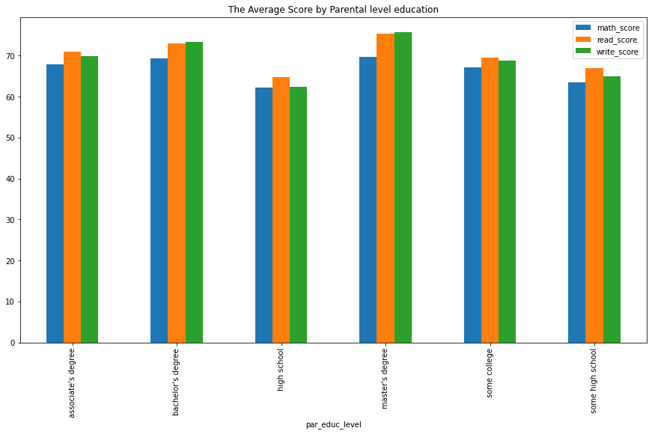

Slide 21
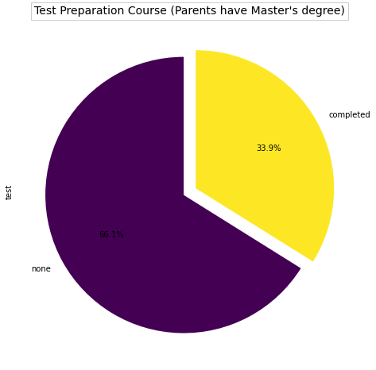
We calculated the average score of each rank before, so we can say that parent's education affect the score but not obviously, because there are still 70%~80% parents without high education degree.

Slide 22
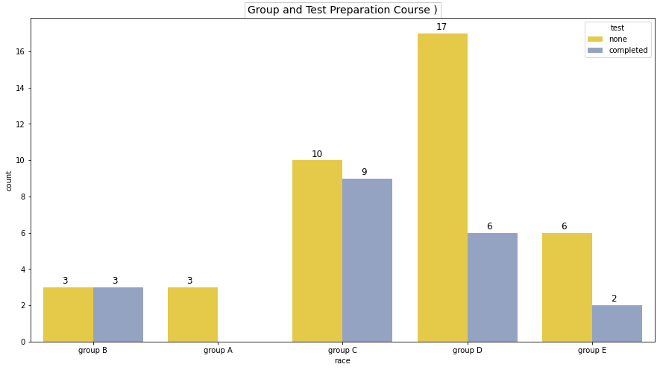
here we can see that the completion of test preparation course is very low than non completed.

Slide 23
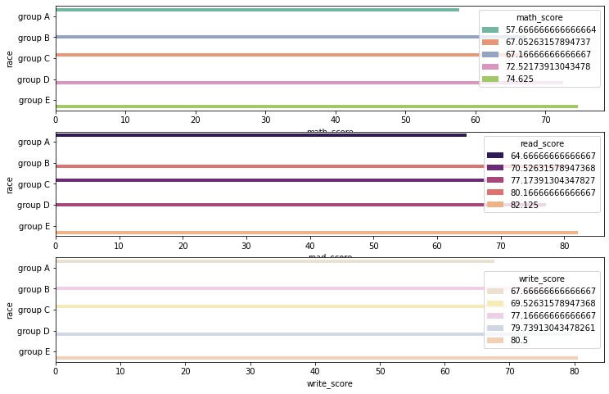
Turns out Group E happens to be performing best in all subjects, while group A performs the worst

Slide 24
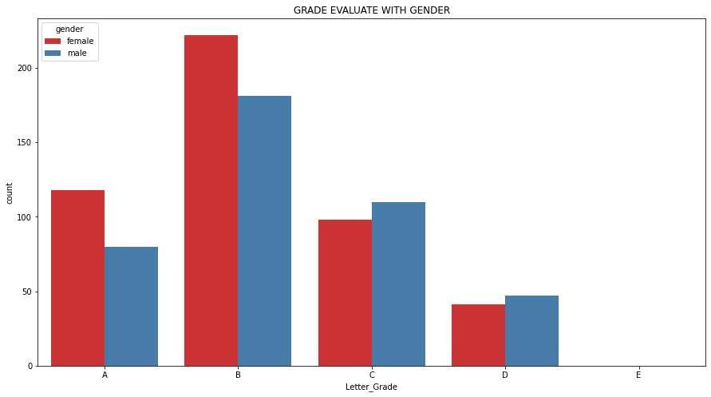
here Female scored better letter grade than Male. and B grade is the highest letter grade comparatively others

Slide 25
Conclusion
There are few conclusions below:
Parents' education level may affect the performance of students, but not the important one.
Finishing preparation course is beneficial.
Having lunch is important to students, and it is also the most significant one.
Gender has no correlation with the score. But in overall performance female students are better.
In summary, if students want to have good performance, they should have enough nutrient and make effort to prepare the test.

